Slide 1
TPN AND HOSPITAL LENGTH OF STAY in NEONATES
Jack McDonnell, MD
Pediatric Hospitalist, Cleveland Clinic Children’s
mcdonnj@ccf.org
April 19, 2018

Slide 2
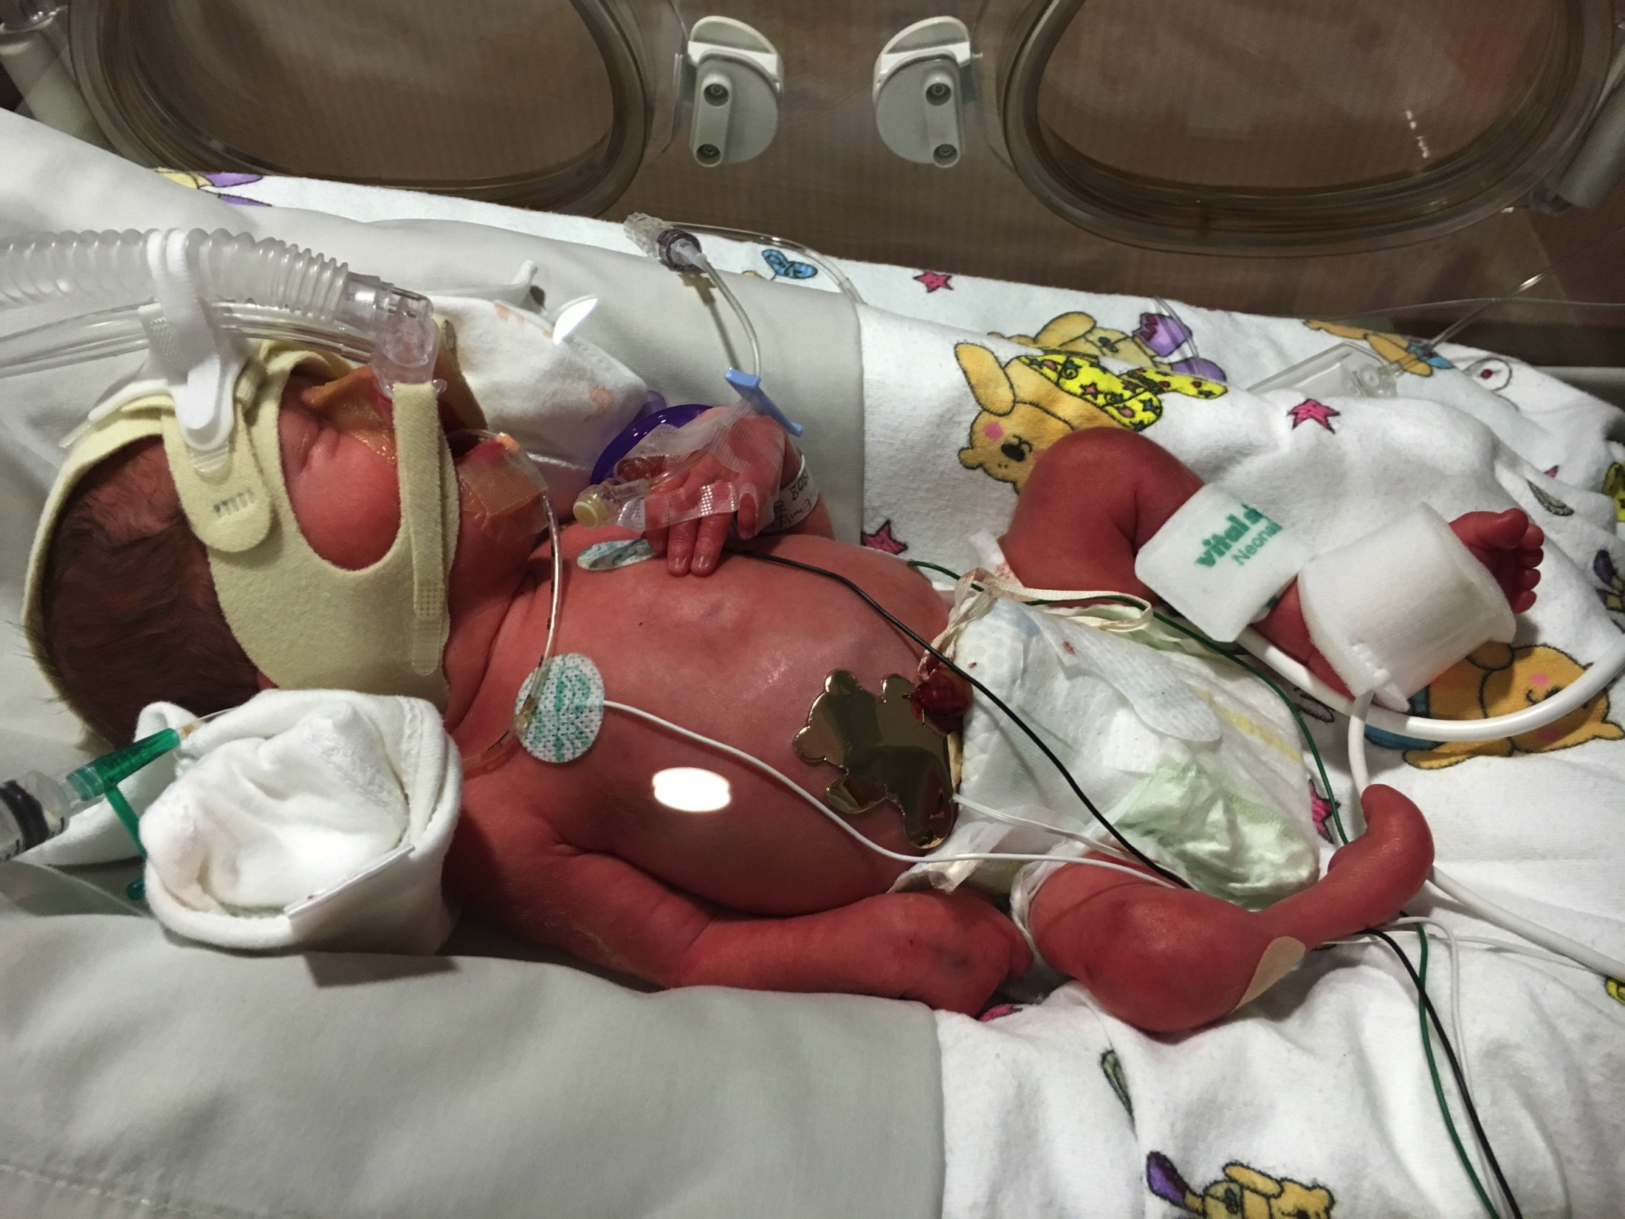
Background
TPN = total parenteral (IV) nutrition
Used when a patient can’t take in nutrition enterally
Used frequently in the Neonatal Intensive Care Unit (NICU)

Slide 3
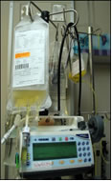
Research Question
How does TPN affect length of stay (LOS) for babies in the NICU?

Slide 4
Data
MIMIC Critical Care Database
Population: 7,246 babies admitted to Beth Israel Deaconess NICU
2001-2012
Exposure: TPN at any time during hospital stay
Determined by ICD9 procedure codes
Outcome: hospital LOS (days)
1,236 infants received TPN
6,010 infants didn’t

Slide 5
Covariates
Cardiac
ASD/VSD
GI
Atresia
Necrotizing Enterocolitis
Birth weight
ELBW, VLBW, LBW, normal
Hematologic
Blood transfusion
Thrombocytopenia
Infectious
Sepsis
Ethnicity
American Indian, Asian, Black, Hispanic, White
IVH (high grade)
Gestational Age
<24, 24-25, 27-28, 29-30
31-32, 33-34, 35-36, term
imputed using simputation
Pulmonary
Hemorrhage
RDS
Other
Notes:
28 covariates

Slide 6
Analysis
Matching
1:1 w/o replacement (greedy)
T: 1229 C: 1229
1:1 with replacement
T: 1229 C: 1229
Weighting
“manual” ATT
TWANG ATT

Slide 7
Propensity Model
Outcome variable = TPN
1/0 Binary
Included all 28 covariates listed previously
Dropped variables corresponding to “normal birth weight,” “term gestation,” and “ethnicity-other”
Dropped 7 observations (PS >= 0.99)
Results
TPN == 1 group
PS range 0.03-0.97
TPN == 0
PS range 0.029-0.96

Slide 8
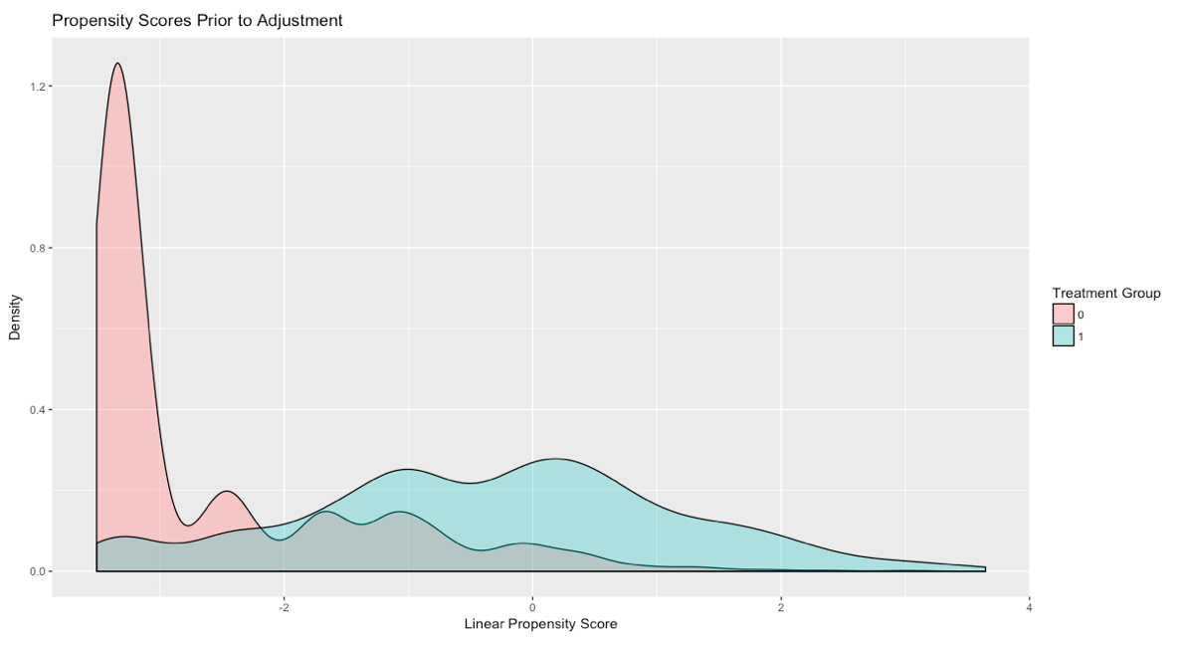

Slide 9
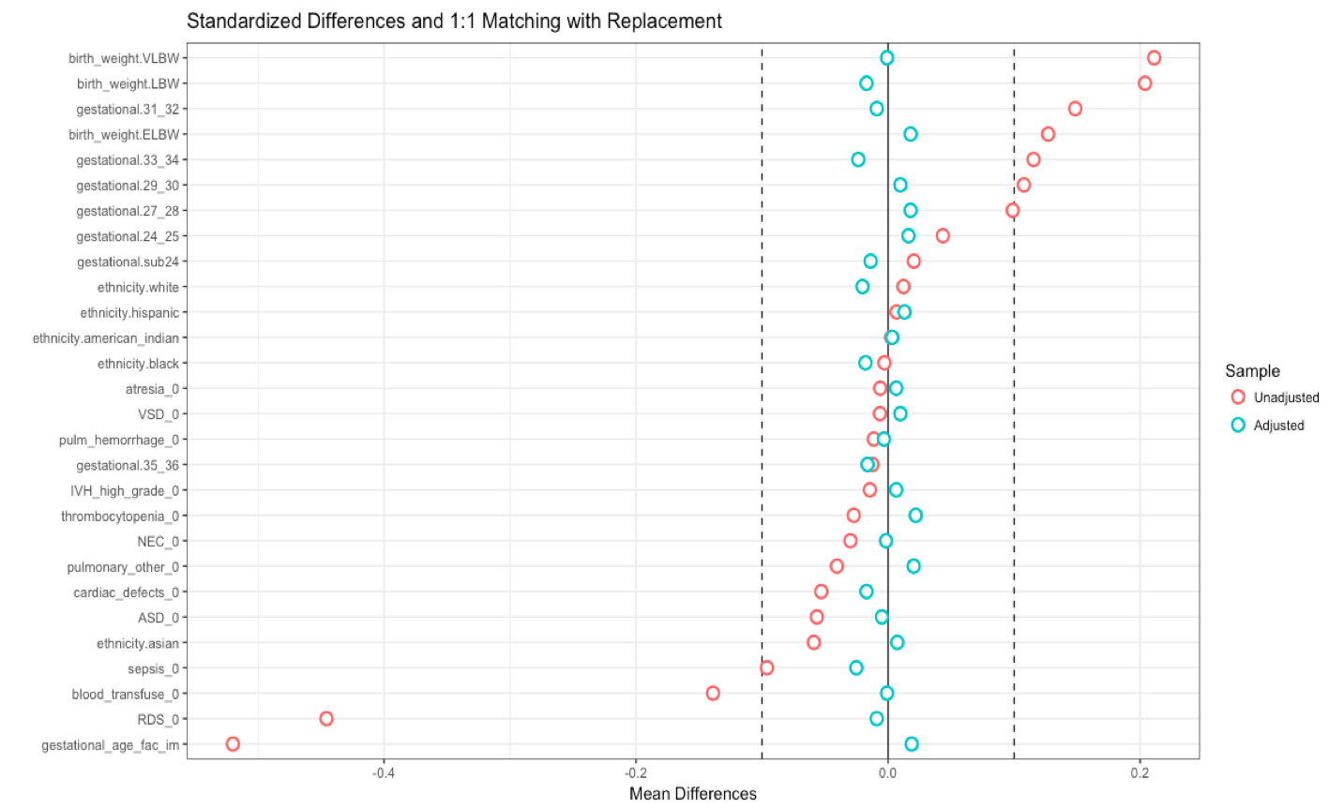

Slide 10

Type of Analysis | Rule 1 | Rule 2 | Rule 3
Unadjusted | 149 | 1.7 | FAIL
1:1 with replacement | 0.2 | 1 | PASS

Slide 11
Matching Results
Method | Estimate | SE | P | CI Low | CI High
unadjusted | 24.5 | 0.57 | <0.001 | 23.4 | 25.7
1:1 match w/ replacement | 7.9 | 1 | <0.001 | 5.9 | 9.8

Slide 12
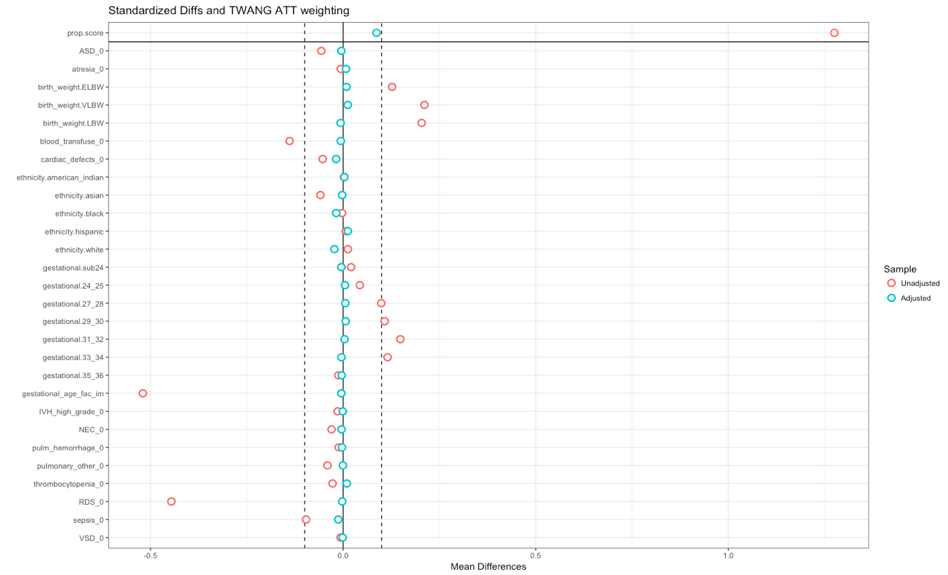
TWANG ATT Weighting

Slide 13
Weighting Results
Method | Estimate | SE | P | CI Low | CI High
unadjusted | 24.5 | 0.57 | <0.001 | 23.4 | 25.7
1:1 match w/ replacement | 7.9 | 1 | <0.001 | 5.9 | 9.8
ATT TWANG weighting | 5.7 | 1.86 | <0.01 | 2.1 | 9.4

Slide 14
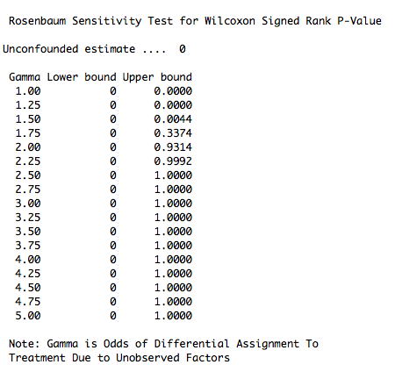

Slide 15

Sensitivity Analysis
two-tailed test, with a 95% confidence level
Γ statistic is between 1.5 and 1.75
where the upper bound for the p value crosses the threshold of α/2=0.025
So this study’s conclusion would still hold even in the face of a hidden bias with Γ=1.5 (but not with Γ=1.75)

Slide 16
Conclusions
TPN use for infants in the NICU studied here was associated with a significant increase in inpatient length of stay
These results were consistent across multiple propensity scoring strategies
Unsure how generalizable this is
Beth Israel Deaconess probably not a “typical” NICU

Slide 17
Statistical Conclusions
Tried 1:1 greedy matching, 1:1 matching w/ replacement, ATT weighting, and TWANG ATT weighting
3 of these worked very well and had consistent results
ATT weighting (without TWANG) balanced the worst, and had a non-significant result
Difficult to work with medium-sized relational databases like MIMIC
Hard to pull all the information together
The more granular clinical information was inaccessible to me due to RAM/memory constraints
Have network/computational space on Cleveland Clinic servers to carry on these studies
However, need to learn SQL to do so

Slide 18

Questions???
QUESTIONS?

